Slide 1
Tame Your Data Infrastructure
How the University of Washington Created a Collaborative and Confident Data Culture on Campus
September 10, 2024
Edify
Notes:
Devin

Slide 2


Meet Your Presenters
Devin Jones
Strategic Leader, Data and Analytics
EAB
Erin Guthrie
Associate Vice President and University Data and Analysis Officer
University of Washington
Notes:
Devin
Before we dive in today, I’d like to take a moment to introduce Ms. Erin Guthrie. I've had the pleasure of collaborating closely with Erin on some of the projects that we'll discuss later in this presentation. Erin, would you like to tell us a bit about yourself and the work you do at the Univeristy of Washington?

Slide 3
About EAB
Notes:
Devin
So before we begin our discussion today, I wanted to take moment to ground everyone in the work that EAB takes part in.
EAB has been supporting schools, colleges, and universities for nearly 45 years, with a team of seasoned education experts committed to being trusted partners to each institution we serve. Our mission is to empower students from kindergarten through career by helping our partners innovate and thrive, whether during times of disruption or stability.
We operate across six major areas:
Institutional Strategy
Marketing and Enrollment
Graduate Marketing and Enrollment
Student Success
Advancement
and Edify: Our higher education specific data warehouse
In short, we aim to drive progress and lasting change for our 2,800 partners worldwide, measuring success by your outcomes.
Alright - let’s jump into our presentation…

Slide 4





Navigating a New Normal
Amid Long-Term Shifts, Institutions without Reliable Data Risk Falling Behind
Imperatives for the next decade
Understand enrollment shifts
Support student readiness
Find sustainable business models
Deliver a “return on education”
Prepare
for AI adoption
Priorities for your data
Track national and state trends
Drill in on specific student populations
Understand how disrupted high school learning is impacting incoming students
Implement data-driven department health checks
Track graduate outcomes
Articulate your unique value proposition
Organize, de-silo, and validate data to leverage
AI tools
Source: EAB interviews and analysis.
Notes:
Devin
To set the stage here, I'm sure that we're all away of the strong headwinds impacting higher education. Because of these - we’re seeing a renewed urgency to act based on sound, trusted data. More specifically, our research team has identified 5 imperatives that all institutions need to grapple with if they’re to thrive across the next decade.
Now where I see schools having success is when their teams are using data to make progress in each of these areas.
For example:
A VP of Enrollment Mgmt gaining a Better Understanding of Enrollment Shifts for specific student population within a larger recruiting area.
Or a Provost that can better understand the academic needs of incoming freshman to deploy early interventions in support of student readiness.
Lastly, we’re increasingly hearing that institutions have begun to recognize the need to get their data house in order if they’re ever going to leverage AI. Because the truth is - whenever your institution decides to leverage AI tools, well-organized, de-siloed, validated data is going to be a prerequisite. Without it, you risk accelerating bad decision-making for your institution.
But the reality is that most schools struggle to turn data into action – especially when it comes to these strategic imperatives.

Slide 5

Edify Is Your Path to a Data-Informed Campus
Make Better Decisions with Data Management Designed for Higher Ed
Build a culture of data confidence
Bring your
data together
Empower your school with insight
Access, Warehousing,
and Integration
Data
Governance
Reporting and
Analytics
Cloud-native, secure, infinitely scalable data lake and warehouse to support critical initiatives
Higher ed best-practice rules and validations to ensure a single source of truth
Self-service, custom, and pre-built analytics to drive efficiency and support decision-making
Extend Your Team’s Capacity
NEW: AI
Professional Services
Interact with Edify in plain
language to find, access, and report on trusted data in minutes
Work with experienced higher
education data experts who understand your environment and goals
Notes:
Devin
So, this is where EAB higher education data warehouse solution comes in:
At a high level, Edify, does three things:
First, we establish integrations to your core source systems. We have a library of pre-built connectors to the most common source systems in higher ed, which makes this process efficient and low lift on your IT team. The data comes into Edify in it’s raw state and you can select the refresh cadence for each source. Is it nightly, is it every 15min?
Next, we’re transforming that ingested data into an out-of-the-box, higher-ed specific data model. This is where we start to create a unified, trusted data set. And we’re not just talking about student data here. It’s finance, enrollment, HR, advancement data. Each entity in the model comes loaded with a plain language data definition, and the requisite SQL transformations. Importantly, while the model is out of the box, it is fully extensible, customizable, and transparent.
So now that we have data flowing in, it’s well governed… now we can use that data for reporting and analytics. A few options here:
Within Edify, there’s a full reporting and visualization suite that allows for no-code report building and dashboard creation. This can be done with or without AI. When using AI, our “Query Assist” tool lets you ask a plain language prompt to generate queries and get answers to stakeholders in a matter of minutes.
As part of that BI environment, partners can take advantage of our pre-built analytic templates – we call them Accelerators. Each Accelerator stems from our decades-worth of research into higher ed and focuses on a core issue. For example, optimizing course planning or looking at strategic enrollment management. Each Accelerator is 80% out of the box, with the remaining 20% customizable.
And lastly, you can point Edify at the reporting tool of your choice. For example, if you’re using PowerBI or Tableau – great! Feel free to keep using those tools, but now it’s fed by a curated data set.
Now at the bottom of this slide you see two foundational elements of Edify. First is our investment in AI. When we flip on our AI features, we’re able to return better-informed responses, more accurate answers, better predictions because your data warehouse includes MORE than just the data. It’s also the higher ed data definitions, the lineage, the context for how folks like to pull reports.
And lastly, is our professional services team. They operate as an extension of your staff [which Erin will go into during this presentation]. You have access to our data scientists, data engineers, integration specialists. These are the folks that will deploy your Edify platform in concert with your team and implement scoped projects.

Slide 6
1
Meet the University of Washington
2
Creating a Confident Data Culture: Impact of Centralized Data System
3
Q&A
Notes:
Devin
So now that we've discussed a bit about Edify, I'd like to turn it over the Erin to give us some background about the University of Washington and how they have been using Edify thus far in their partnership. Erin, would you like to tell us a little ore about U-dub?

Slide 7



University of Washington
Background
Public research university in Seattle, WA
52,000 credit-earning students
Abou the Partnership
UW’s data management landscape, including disparate systems and a federated data and reporting structure, posed challenges to efficiency and stretched the limits of our data teams’ resources.
They partnered with Edify last year to revamp their data model and ensure stakeholders across campus have the data they need to make informed decisions.
Notes:
UW

Slide 8







A Unique Data Management Landscape
UW’s sprawling and complex infrastructure made data management, democratization, and governance difficult
Homegrown mainframe-based financial system
Transition to Workday Financials
Homegrown legacy SIS
Central IT + Enterprise Level BI
Small IR team to manage reporting needs
Varied tech across multiple campuses
Several barriers prevented the IR team from taming these complexities
Inaccessible backend system
Inability to integrate additional data
Inability to house data models for analysis
Notes:
UW

Slide 9
Accelerating the Path to Data Progress
Edify Acts as a True Data Partner
UW’s Data Challenges | Early Wins with Edify
Disparate systems and a federated structure make compliance reporting cumbersome—we need a partner who can understand and provide a sustainable data management infrastructure that empowers UW’s data teams | UW remained autonomous in process EAB delivered Proof of Concept of Deans’ Dashboard for custom KPIs
Data requests need to be met more efficiently for Provost Office and senior leadership decision-making | Edify streamlined insights to support leadership planning and decision-making
Lack of skills alignment with traditional IR office, and a lack of IT support resources in the central Provost Office | EAB extended UW’s existing team with EAB’s inhouse data experts
Notes:
UW

Slide 10
1
Meet the University of Washington
2
Creating a Confident Data Culture:
Impact of Centralized Data System
3
Q&A
Notes:
UW

Slide 11
Building a Data Warehouse Together
UW’s Journey to building Deans’ Dashboard
July 6, 2023
EAB completed initial technical and project calls with the UW team
January 30, 2024
EAB and UW completed a workspace for Deans to reference reliable data
Future Goals
Inspire more strategic conversations using data
November 17, 2024
After internal discussions, UW outlined their vision and EAB delivered a data model proof of concept within weeks
Today
With other data needs, UW uses customizable templates within Edify, saving time
Notes:
UW

Slide 12
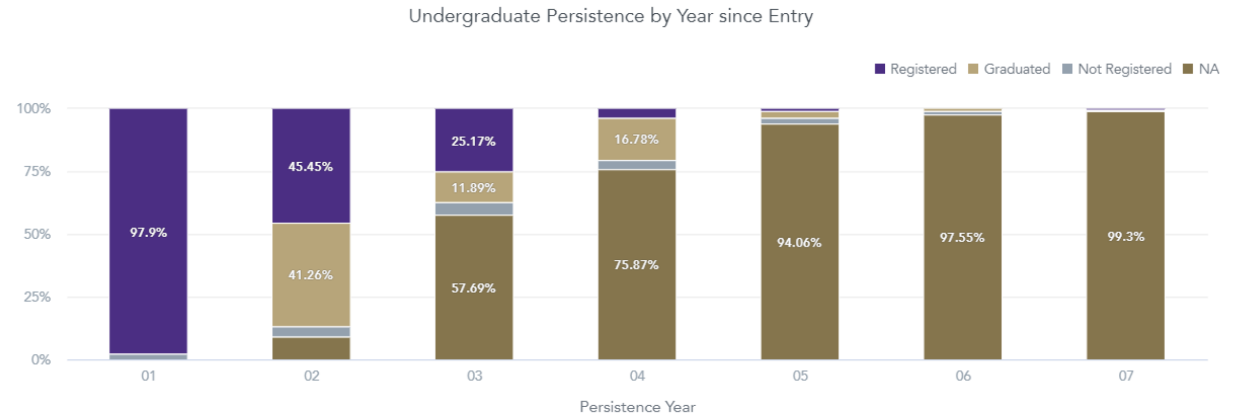
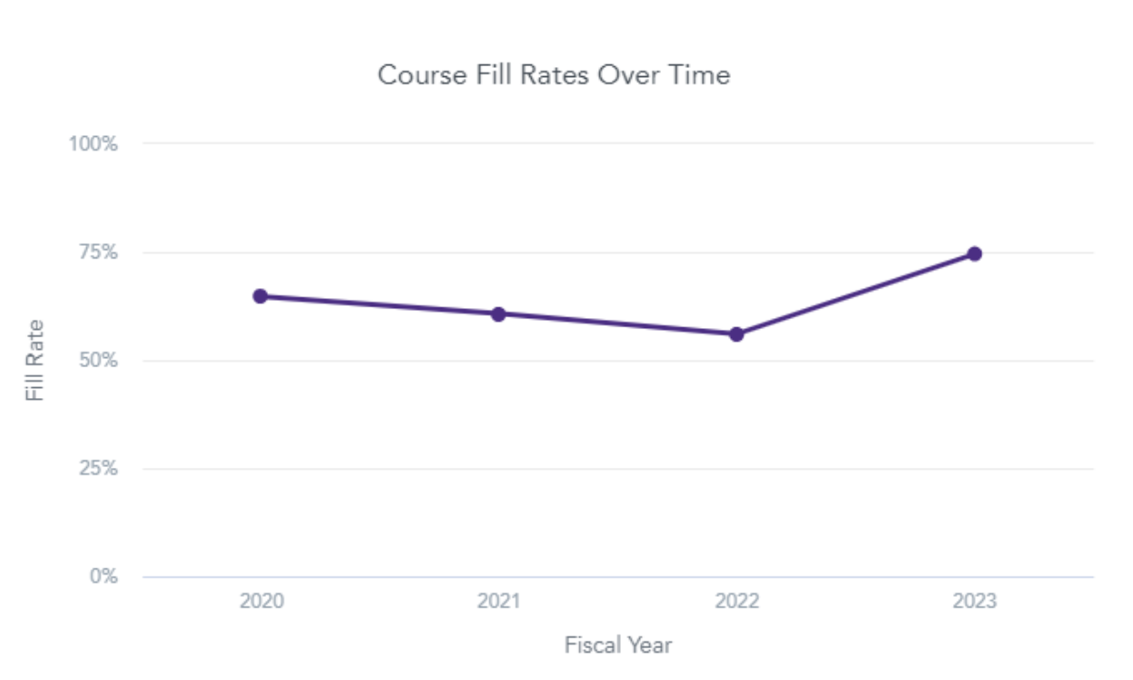
Inside the Deans’ Dashboards
Dashboards Provide Actionable Insights by Department and College
Six Dashboards:
Course Capacity (right)
Course Completion
Course Demand
Enrollment
Instructor Workload
Student Outcomes (above)
Features:
Quarterly updates
Exporting and scheduling capabilities
Replicable and customizable data model
Notes:
UW

Slide 13
Data Guides Strategic Decision-Making
Questions Deans Can Answer with the Dashboards
?
?
?
?
“How has my unit changed over time?”
“How do population changes vary?”
“How have course fill rates changed?”
“How have student credit hours changed over time?”
?
?
?
?
“Which departments enroll the most and least non-majors?”
“What are the most common majors?”
“How do graduation rates compare across UW?”
“How do persistence rates compare across UW?”
Notes:
UW

Slide 14


Simplified Processes for Analysts and Deans
UW Created a Single Source of Truth for Academic Data
Focus Time on High-Priority Tasks
Understand and work with data rather than fixing queries and answering ad-hoc data requests
Analysts
Point to Data for Reviews and Decisions
See high level overview with ability to “drill down” into the data as needed
Able to schedule sends for key metrics and insights
Don’t need to know nuanced definitions as it’s in process
Deans
Notes:
UW

Slide 15


Key Takeaways From Today’s Session
Centralized and democratized data supports consistency, collaboration, and confidence on campus
Collaboration is key to decentralizing and democratizing data
Data informs decision-making and inspires strategic questions to support the institution’s mission
Notes:
Devin
Erin, thank you for sharing the important work UW is taking on with Edify. As we wrap up, I want to highlight some key takeaways from our presentation today:
First, centralized and democratized data plays a crucial role in ensuring consistency, collaboration, and confidence across campus. When data is accessible, everyone has the tools they need to contribute meaningfully.
Second, collaboration is key to achieving this decentralization and democratization. Breaking down silos and making sure the right people have access to the right data is critical.
Finally, data not only informs decision-making but also sparks the strategic questions that align with and support the institution’s mission, as Erin helped highlight today.

Slide 16
1
Meet the University of Washington
2
Creating a Confident Data Culture: Impact of Centralized Data System
3
Q&A
Notes:
Devin

Slide 17
Questions?
Devin Jones
Strategic Leader, Data and Analytics
EAB
Erin Guthrie
Associate Vice President and University Data and Analysis Officer
University of Washington
Notes:
Devin
What's next for UW x Edify?
What were the key early wins for UW in terms of using Edify to achieve their data management goals?
What steps is UW taking to ensure all stakeholders felt confident using the newly centralized data system?

Slide 18

How Can We Help?
1
Building my data warehousing needs
I’d like to speak to an EAB expert about…
2
Assessing my institution’s unique data infrastructure
3
Centralizing data sources
4
Another data or analytics need
Notes:
DEVIN

Slide 19




Related Resources For You
1
Receive today’s slides
in a follow-up email
2
Register for our webinar on September 17 about how embedded AI enhances Edify
3
4
Subscribe to our blog and receive EAB's newest data & analytics insights directly to your inbox
See a demo of Edify
Notes:
DEVIN

Slide 20

Let Us Know Your Thoughts!
We value your feedback.
Please take a few minutes to complete the short survey that pops up in your browser.
Thank you!
Notes:
Devin
Lastly - After the session concludes, a survey will appear in your browser. Please fill that out for us so that we know how we did—we value your feedback!

Slide 21
Notes:
DEVIN

